Slide 1
Predicting Mental Health with Sociodemographic Factors
Jana Kassem, Jade Lightfoot, Swati Misra, Amanda Roberts, and Ridisha Saquib
Notes:
Jade

Slide 2
Our Data
Sociodemographic
Health
Source: American Community Survey (ACS) 2015 5-Year Estimates (2015-2019)
Variables: economic, education, and demographic
Source: 500 Cities CDC (2015-2016)
Variables: respiratory, cardiovascular, and mental health
Notes:
Jade- Our data is a combined dataset with sociodemographic and health data. The sociodemographic data coming from

Slide 3
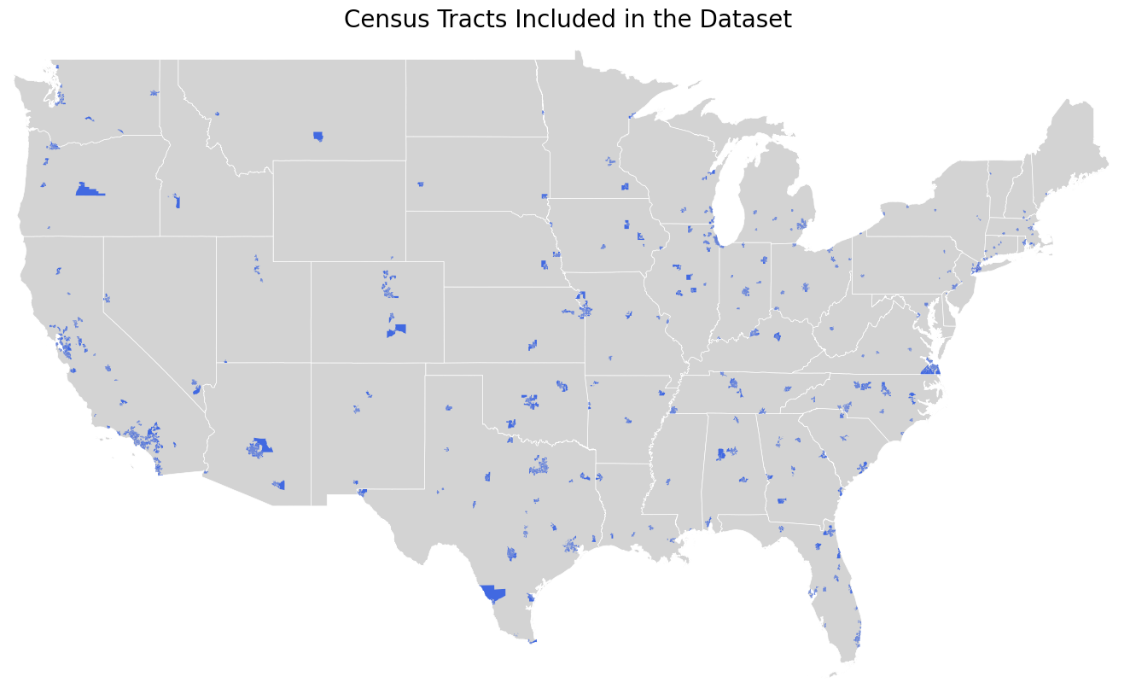
Notes:
Jade- Gives a general overview of the census tracts included within our dataset nationwide.

Slide 4
Predictive Problem
Problem Definition
Predicting mental health percentage based on sociodemographic factors
Goal
Identifying risk factors that can predict developing mental health in individual tracts
Why
Target?
Poor mental health affects workforce productivity, healthcare burden, and overall quality of life
Inference
Inference supports understanding patterns, not making decisions. Policy makers read inference results to design interventions, but the model itself is not prioritizing or ranking tracts.
Notes:
The reason we chose this problem is because..
Poor mental health affects workforce productivity, healthcare burden, and overall quality of life. Understanding which sociodemographic factors are associated with higher mental-health burden is essential for researchers and maybe policymakers.
But essentially THIS IS NOT A POLICY PROBLEM it is inference → I want to emphasize that our approach is towards inferencing to support understanding patterns, and not decision making. Policy makers read inference results to design interventions, but the model itself is not prioritizing or ranking tracts.

Slide 5
Choice of Variables
Variables
Why?
Target: Mental Health %
Features:
Median Income, Poverty %, Unemployment %
Highest Education HS Graduation %, Highest Education BS Graduation %
Median Age, White Only %, Black Only %, Asian Only %, Hispanic %, Other %
Demographic features rather than health features allows for a better idea of risk factors
Prevents data leakage and reverse causality
Reduces collinearity
More generalizable results
Notes:
Swati
To predict our outcome variable of mental health percentage in individual tracts, we used socioeconomic and demographic features like income, unemployment, education, and race.
We chose to shift from other health factors to these demographic variables in order to create a more generalizable model.
We also wanted to better prevent data leakage, as health variables are more inclined to be variables collected at time of prediction, and reverse causality.
Lastly, choosing these variables allowed us to reduce collinearity.
.

Slide 6
Choice of Regression
Why Regression?
Alternative Approach Considered
Gradual changes across communities
Preserves variability & provides precise insight
At the tract level, physical and behavioral factors help identify communities at greater mental health risk and guide targeted policy interventions.
Could have modeled as classification (High, Medium, Low)
Force artificial cut offs between groups
Lose detail about actual percentages
Notes:
Swati
“We chose regression because mental-health percentages change gradually across communities, and regression preserves that full range instead of forcing everything into categories.
It gives us more precise insight into how income, education, and other demographic factors influence mental-health levels.
We did consider classification, but that would require arbitrary cutoffs like ‘high,’ ‘medium,’ and ‘low,’ which would lose a lot of detail in the actual percentages.

Slide 7
Data Splitting
Spatial
Checks
Split by county because nearby tracts may not be independent
Random splits caused spatial leakage
Measures true generalization to new geographic areas
60/20/20 by county (train/validation/test) → counties don't cross splits
Cross Validation: Use GroupKFold (by county) on the train set only
No county appears in multiple splits
Target distribution (MentalHealth_Pct) is similar across splits
Basic balance of tract counts per split
Notes:
Swati
For our data splitting, we used a spatial approach rather than random splits.
Nearby census tracts tend to be similar, so splitting by county helps avoid spatial leakage and gives us a more realistic measure of how well the model will generalize to new geographic areas.
We used a 60/20/20 train-validation-test split by county, and for cross-validation we applied GroupKFold so no county appears in multiple folds.
We also checked that counties never crossed splits, that the mental-health target distribution looked similar across the sets, and that each split had a reasonable number of tracts.

Slide 8
Beta Regression
Why
Strengths
Target is a proportion bounded between 0 & 1.
Mental-health proportions show heteroskedasticity and skew.
Relationship between socioeconomic factors and mental-health proportion is nonlinear.
Handles bounded continuous outcomes properly.
Interpretable coefficients
Well suited for health application
Assumptions
Limitations
Dependent variable ∈ (0, 1).
Relationship between predictors and mean mental health proportion is modeled through a link function.
Cannot automatically learn complex nonlinear patterns.
Sensitive to outliers and extreme proportions.
Notes:
Jana
So, the first model we used was beta regression. We chose this model because our target variable—the percentage of people in a tract who report poor mental health—is a proportion bounded between 0 and 1. Beta regression is ideal for this type of data since it can handle heteroskedasticity and capture asymmetry, unlike linear regression.
Some of its strengths include handling bounded continuous outcomes, having interpretable coefficients similar to logistic regression, and being well suited for health applications, which aligns with the goal of our project.
However, there are also some limitations. Beta regression isn’t as flexible for nonlinear relationships, and it can be sensitive to outliers or extreme proportions.
Finally, the key assumptions are that the dependent variable must fall between 0 and 1, and that the relationship between predictors and the mean outcome is modeled through a link function.

Slide 9
Loss Function & Hyper Parameters
Loss: Negative log-likelihood (NLL) → Matches likelihood for proportions & handles heteroskedasticity
Hyperparameter: Link function ∈ {logit, probit, cloglog}
Tuning: 5-fold CV(by county)
Result: Probit (lowest CV MSE → best predictive performance)
 | MSE | R²
Logit | 1.68 | 0.85
Cloglog | 1.69 | 0.85
Probit | 1.66 | 0.86
Notes:
Jana
To choose the optimal link function (our hyperparameter), we used 5-fold cross-validation, evaluating each function using the mean MSE and R squared (because directly measures prediction error and penalizes large mistakes) . From the table, you can see that all of them performed similarly, with probit having the lowest MSE and highest R squared we decided to chose that one.
The loss function for beta regression is the negative log-likelihood, which measures how well the model’s predicted distribution matches the observed proportions. It’s designed to handle heteroskedasticity and is appropriate for data that are bounded between 0 and 1.”

Slide 10
Random Forest
Why
Strengths
Captures complex, nonlinear socioeconomic patterns behind mental-health prevalence
Automatically models interactions without you specifying them
Robust to skewed predictors like income
Naturally captures nonlinear and interaction effect
No need to transform or normalize variables
Provides interpretable feature importance measures
Assumptions
Limitations
Minimal distributional assumptions.
Training data are representative of what you’ll predict on.
Predictors have real relationship (not all noise)
Risk of overfitting without tuning.
Importance measures can be biased.
Harder to explain relationships compared to Beta regression.
Notes:
Ridisha
Why:
“Random Forest is a great fit for our problem because mental-health outcomes depend on complex, nonlinear socioeconomic patterns. RF automatically captures interactions between income, education, and race without us having to specify them. It also handles skewed variables like income very well.”
Strengths: “It works well out-of-the-box — no need for normalization — and it naturally models nonlinearities. It also gives us feature importance, which helps explain which sociodemogrqohic factors matter most.”
Assumptions: “Random Forest makes very few statistical assumptions. The key requirements are simply that our training data is representative of the counties we want to predict, and that the predictors actually have a true relationship with the target variable."
Limitations: “The main drawback is the risk of overfitting if we don’t tune hyperparameters. Its importance measures can also be biased, and the model is less interpretable than Beta Regression, and more computationally expensive”

Slide 11
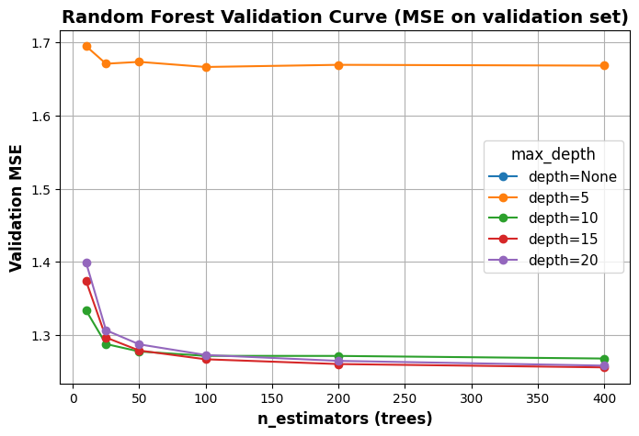
Loss Function & Hyper Parameters
Loss: MSE (squared error) during tree splitting/aggregation → penalizes large errors, produces calibrated continuous scores
Hyperparameters tuned: highest impact knobs for MSE & energy
n_estimators: Chose 100 trees from MSE
max_depth: Chose 15 for being least overfit & energy efficient
Notes:
Ridisha
I say loss functions stuff from the slides already
Hyper parameters tuned:
Number of trees and max depth is our Highest knobs for MSE & Energy
MSE is best for tuning because it directly measures prediction error and penalizes large mistakes more strongly than RMSE or R²
As u can from the plot w y axis being MSE. We selected 100 trees because performance plateaued after this point, and max_depth = 15 because it produced the lowest MSE without overfitting.

Slide 12
Evaluation
Why Calibration Curve & Error? (Inference Problem)
Inference requires precise predicted values, not ordering
Shows how close predictions are to the true values by comparing them to 45° perfect calibration line
Shows average distance from the diagonal, giving a single interpretable number
AUC evaluated ranking, tells nothing about actual predicted values
Notes:
Ridisha
✅ Why Calibration for Inference?
Inference requires precise predicted values — not rankings, not classifications. We numerically close to the real mental-health percentage. Calibration helps achieve this goal
Calibration curves compare the model’s predictions to the 45° line. If points lie on the line, the model is giving truthful, unbiased estimates
Calibration error gives a clean, interpretable summary of how far predictions deviate from the truth. Lower calibration error = more trustworthy estimates.

Slide 13
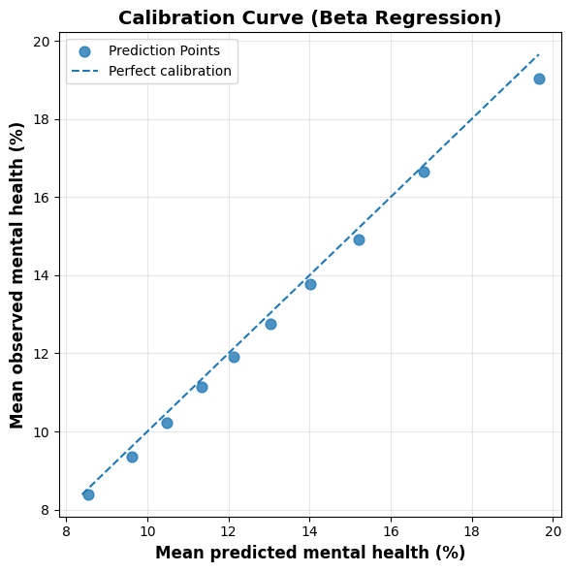
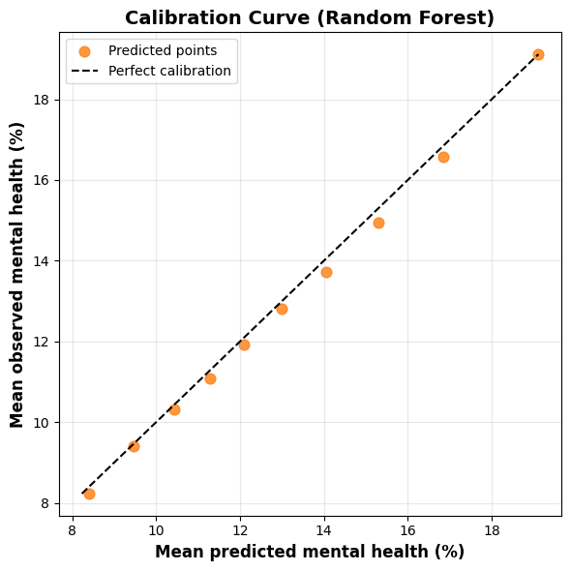
Evaluation
Notes:
Ridisha
Both models track the 45° line closely, showing good calibration across counties.
Random forest is slightly better calibrated, with points staying nearer to the diagonal in the calibration plot.

Slide 14
Evaluation
Why Calibration Curve & Error? (inference problem)
Interpretation
Inference requires precise predicted values, not ordering
Shows how close predictions are to the true values by comparing them to 45° perfect calibration line
Shows average distance from the diagonal, giving a single interpretable number
AUC evaluated ranking, tells nothing about actual predicted values
Calibration Error
Random Forest: 0.188
Beta Regression: 0.266
Both models remain well calibrated across unseen counties.
Random forest is slightly more calibrated than beta regression
Notes:
Ridisha
I say the same thing from the slides

Slide 15
Model Performance and Energy Usage
Both models consume extremely little energy
Random forest’s energy is higher than GLM’s
At large scales, these are noticeably higher carbon emissions
GLM-probit is more sustainable choice
Energy and CO₂ values are reported per 1,000 predictions for easy comparison
 | Beta Regression | Random Forest
Train: Energy (kWh) | 0.00 | 1.0 x 10^-5
Train: CO2 (kg CO2eq) | 0.00 | 4.0 x 10^-6
Test: Energy (kWh) | 0.00 | 0.00
Test: CO2 (kg CO2eq) | 0.00 | 0.00
Calibration Error | 0.266 | 0.188
Notes:
Jana
So here we compare model performance and energy usage. Both models use almost no energy, but random forest does require slightly more than beta regression. In our case that’s totally fine, because we aren’t generating predictions very often — so the higher cost at training time isn’t a real concern.
What is useful is that random forest ends up being better calibrated, with a lower calibration error than beta regression. That means its predicted mental-health percentages line up more closely with what we actually observe. Overall, even though it’s a bit heavier, random forest gives us the better-performing and better-calibrated model for this task.

Slide 16
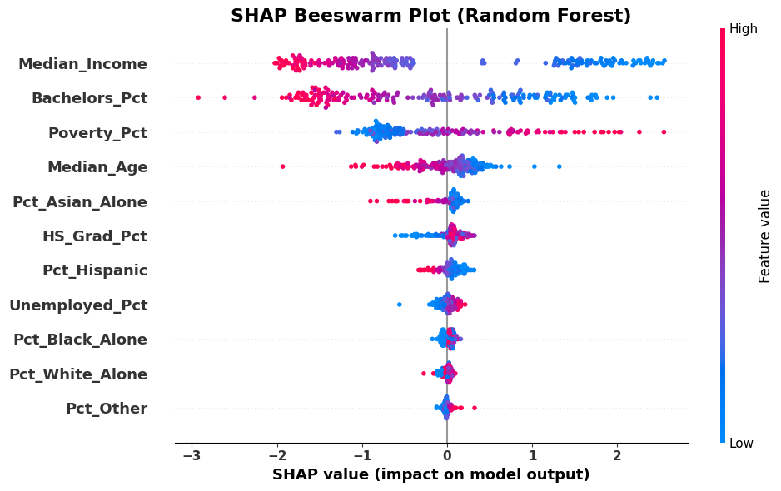
SHAP Values
Highlights
Socioeconomic factors are the top 3 features
Race plays a minor role
Top Interpretations
↓ predicted mental health
↑ median income
↑ bachelors %
↓ poverty %
↑ median age
Notes:
Amanda
For interpretation, we’ll be moving forward with random forest since it was the better model in our case.
This SHAP beeswarm plot shows which features the model relies on the most when predicting mental health prevalence across tracts. The top drivers are socioeconomic factors such as median income, bachelors percent, poverty percent, and median age. Race variables and high school % appear lower in the ranking meaning they play a smaller role in the model’s predictions.
Looking at the directional patterns and the color scale, lower predicted mental health prevalence (to the left of the x-axis) is associated with higher median income (red values), higher bachelor’s %(more red), lower poverty % (blue), and a higher median age (red). Overall, the model is picking up stronger socioeconomic patterns and weaker demographic ones.

Slide 17
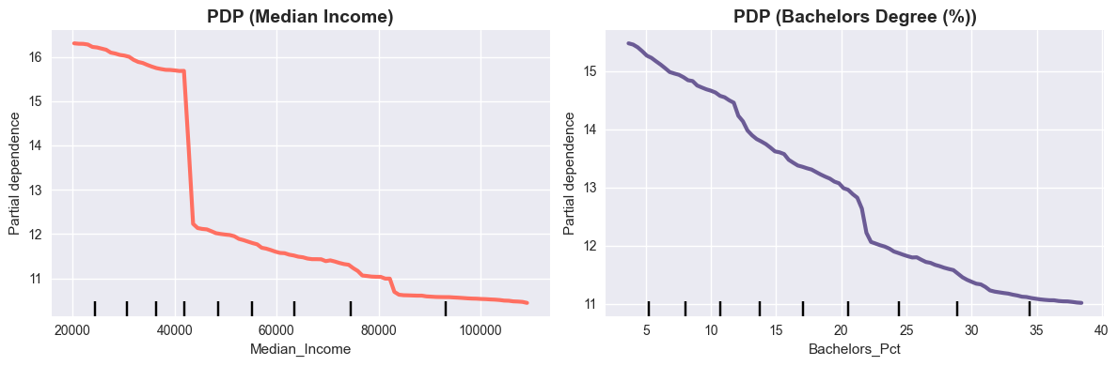
PDP: Median Income
Steep decline in predicted poor mental-health days as median income rises
Sharp drop below ~$50k, then curve flattens
High predicted mental health prevalence is associated with low-income regions
Notes:
Amanda
We decided to look into our top 2 features from the SHAP values, and we’re doing PDP to show the marginal effect of that feature on the predictions.
This PDP shows how predicted mental health prevalence in a tract changes as median income rises, holding other features constant. You can see a steep decline in predictions as income increases around 45k, and beyond that, the curve flattens, suggesting diminishing returns. Essentially, high predicted mental health prevalence is associated with low-income regions.

Slide 18
PDP: Bachelor’s %
Steady decline in predicted mental health prevalence as bachelor’s % increases
High predicted mental health prevalence is associated with higher educated regions
Notes:
Amanda
Remember that bachelor’s % is the % of those with their highest degree attainment being a bachelor’s degree.
This PDP shows how predicted mental health prevalence changes as bachelors % increases, holding everything else constant. The curve has a steady downward slope, which means higher bachelors % is associated with lower predicted mental health prevalence.

Slide 19
Concluding Thoughts
Summary
Income, bachelor’s education, and poverty are the strongest predictors of mental health burden at the tract level
These findings support scientific understanding, helping researchers quantify how much demographic and socioeconomic factors contribute to mental-health variation.
Provides evidence for public-health reports, academic work, causal follow-up studies, and evaluation of structural disparities
Helps community organizations, local governments, and health systems understand which structural factors deserve attention, without ranking or allocating resources.
Next Steps
Validate models with newer ACS and CDC data to track change over time
Explore spatial models to deepen understanding of geographic disparities
Notes:
So in conclusion, Our results show that income, bachelor’s education, and poverty are the strongest predictors of mental-health burden at the tract level.
These findings strengthen scientific understanding by quantifying how demographic and socioeconomic factors drive variation in mental health.
They also provide evidence that can support public-health reports, academic research, causal follow-up studies, and evaluations of structural disparities.
Ultimately, this helps community organizations, local governments, and health systems understand which structural factors deserve attention—without ranking or allocating resources.
For next steps, we would validate the models using newer ACS and CDC data to track how these patterns change over time, and we’ll explore spatial models to better understand geographic disparities.”

Slide 20
Thank you!
Any questions?
Notes:
Amanda

